Slide 1
MUNCH
Pitch Deck
Gabriel Soares & Gabriel Mendonca

Slide 2
Table of contents
01
02
03
04
05
06
The Problem
Our Solution
Proposed UI/UX
Backend
Dataset
Questions?

Slide 3
01
The Problem

Slide 4
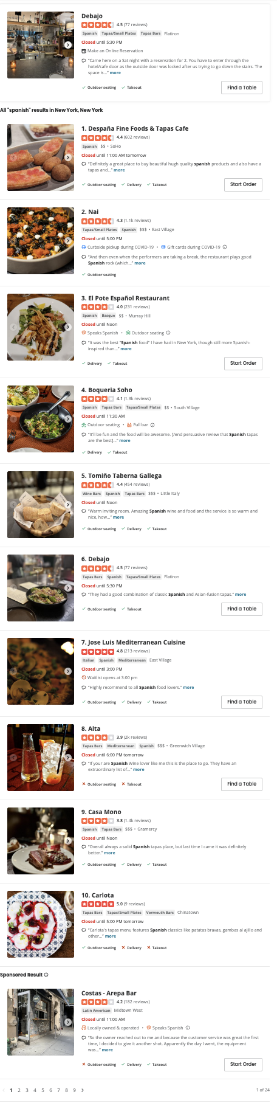
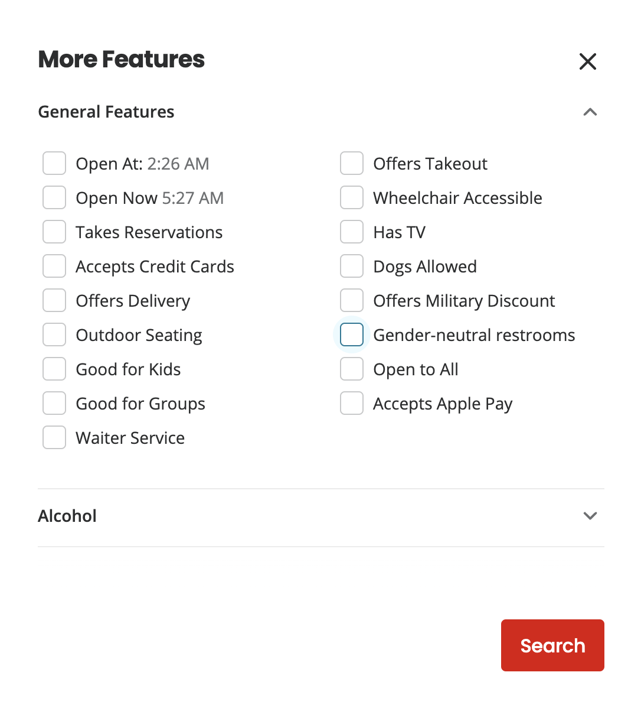
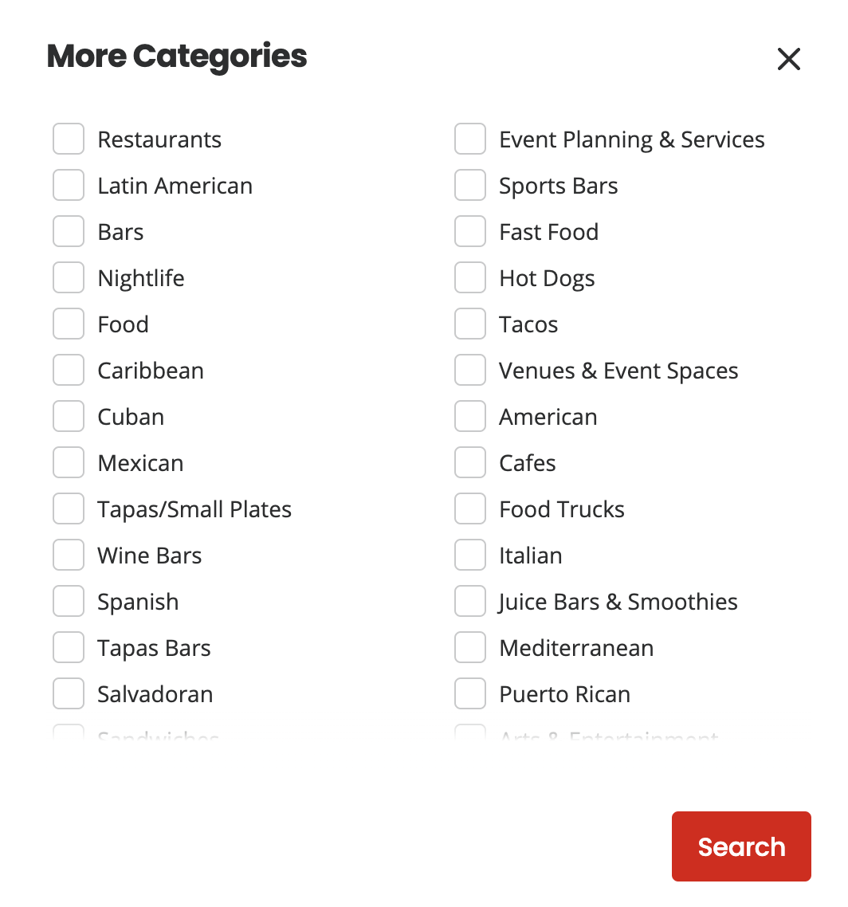
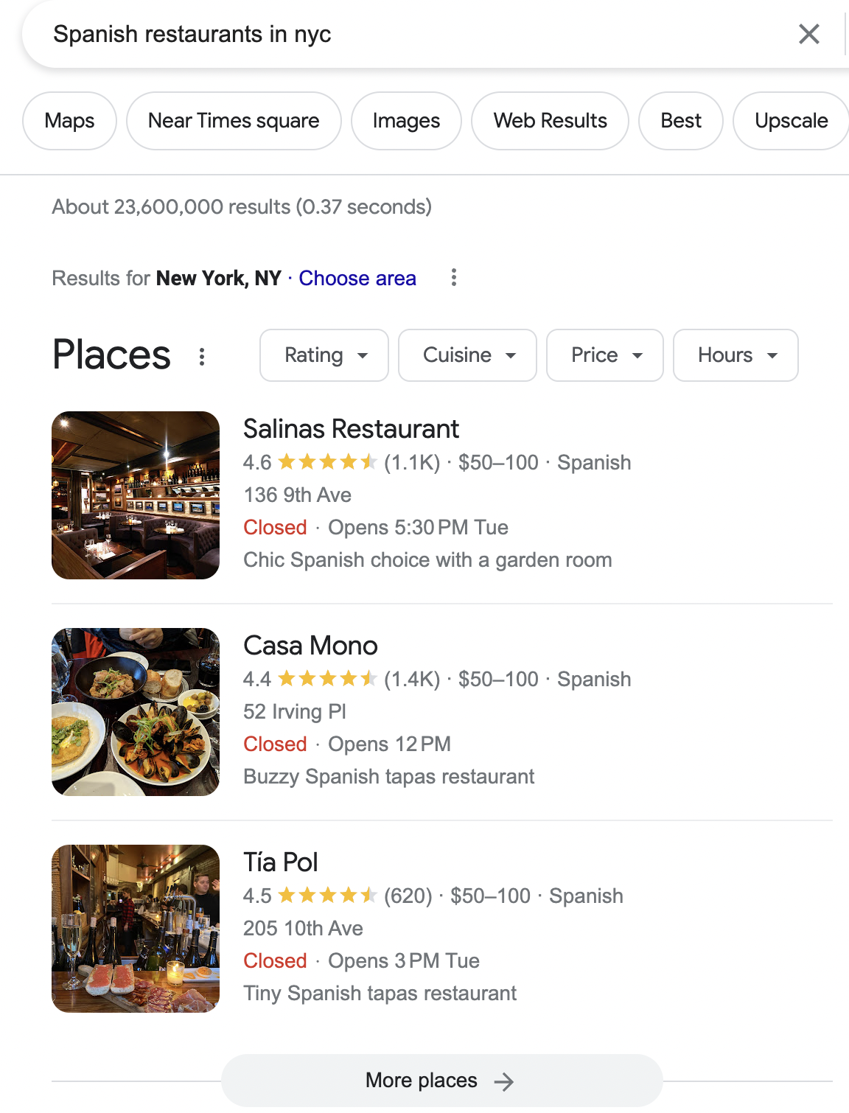
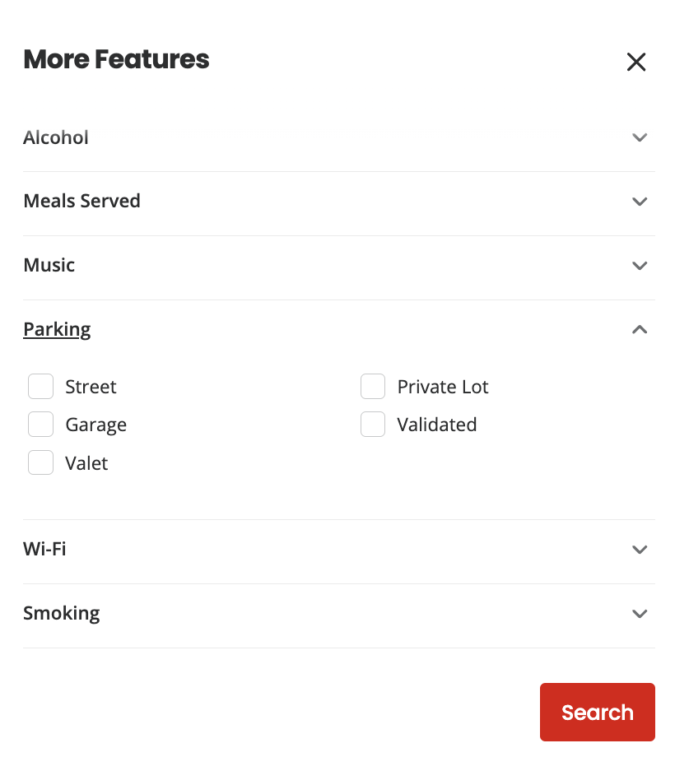
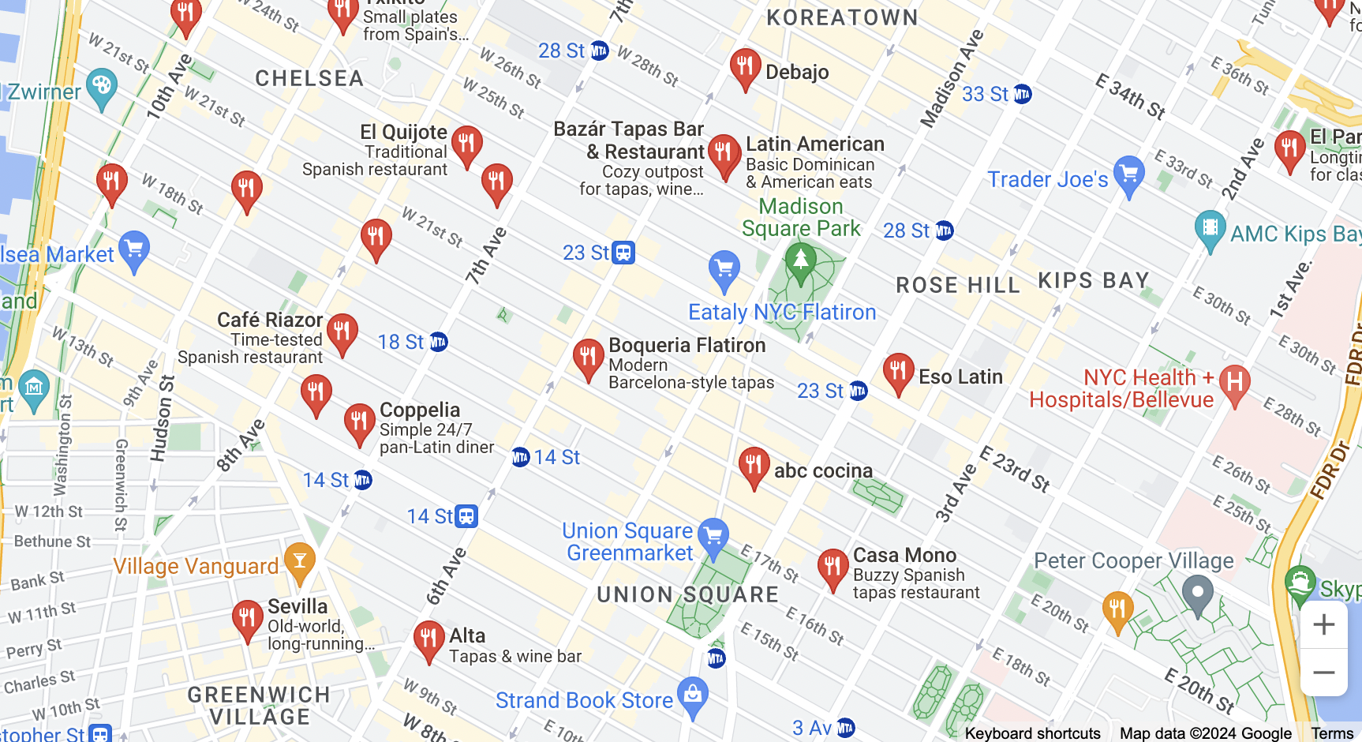
The Problem

Slide 5
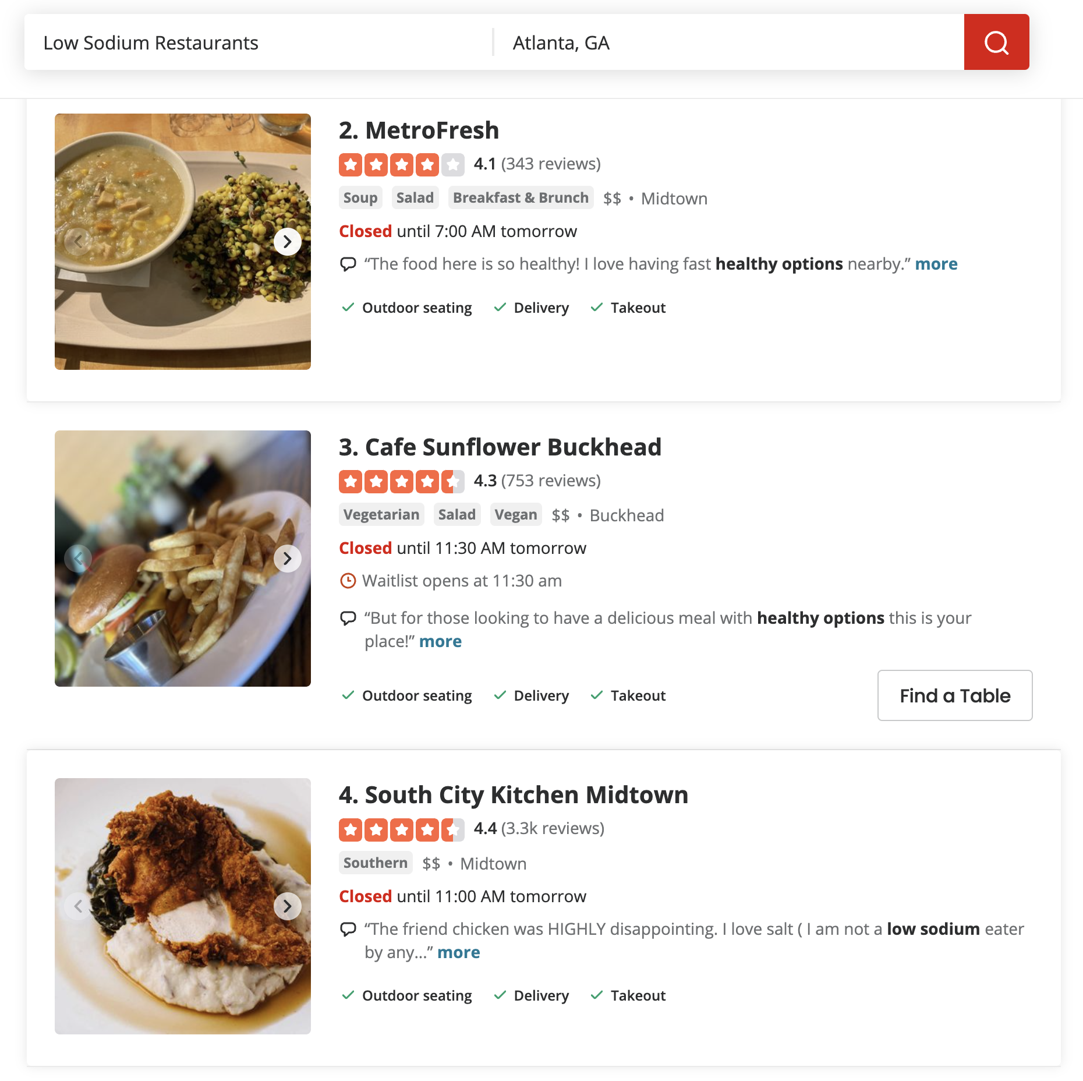
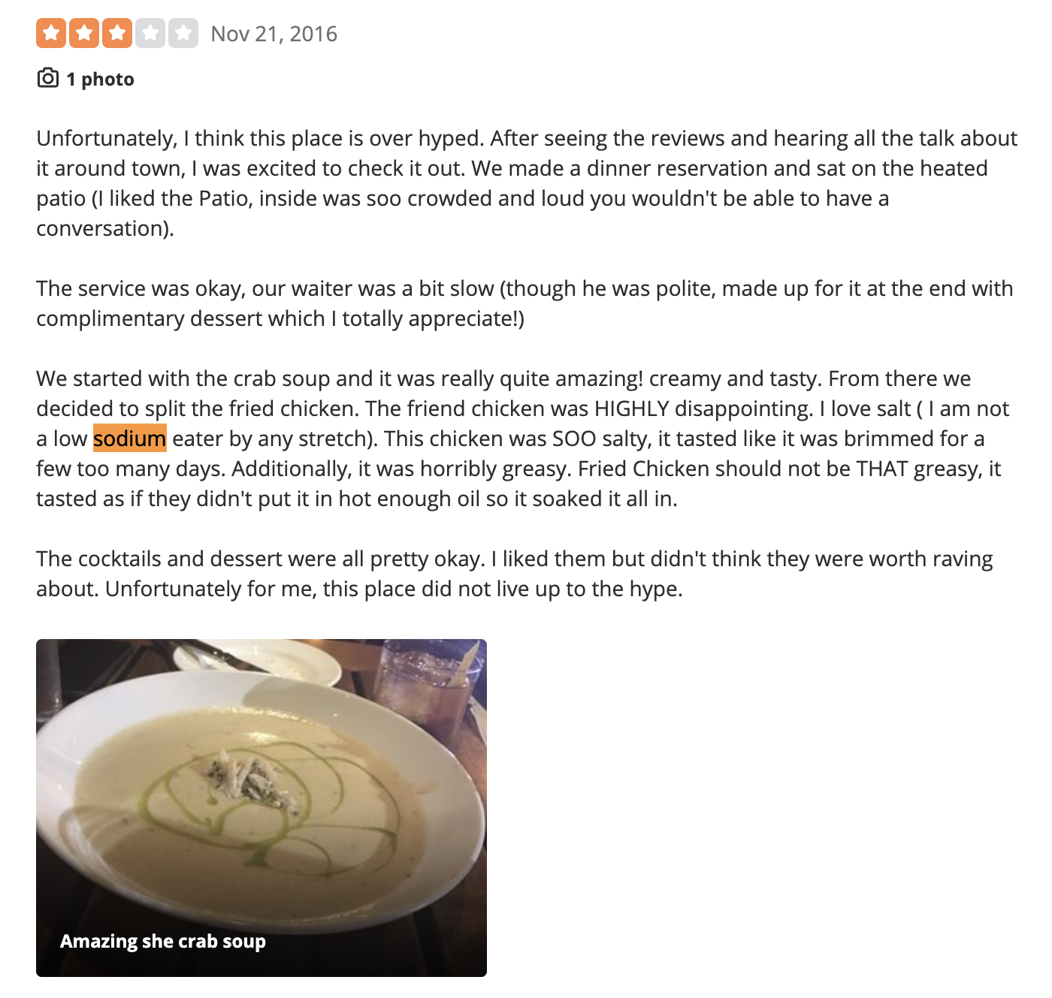
Poor Review Retrieval - Using Basic Keyword Search

Slide 6
02
The Solution

Slide 7




Key Features
+
Restaurant Search
Conversational
Flexible LLM Search to quickly find restaurants
Narrow down the search
Talk to the AI and ask questions back and forth
Very specific queries

Slide 8
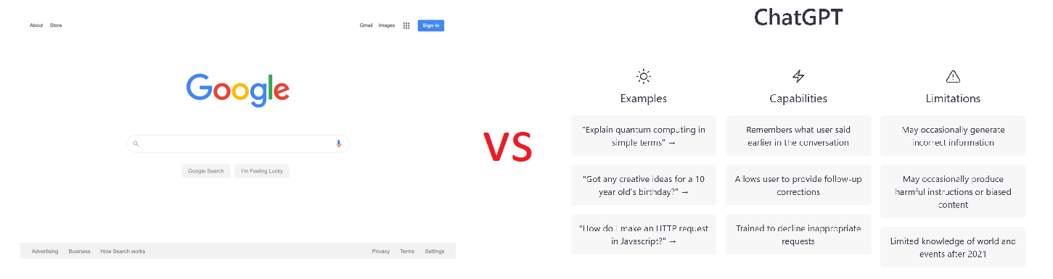
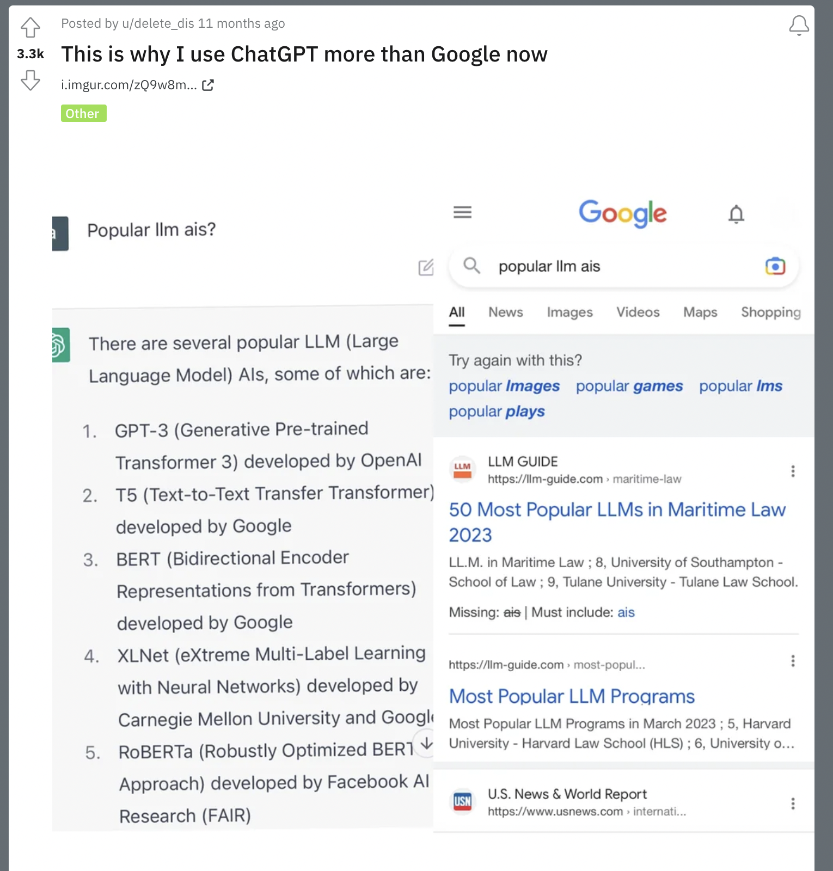
Google Search vs ChatGPT Search
Why not for restaurant search?

Slide 9
03
Proposed UI/UX

Slide 10
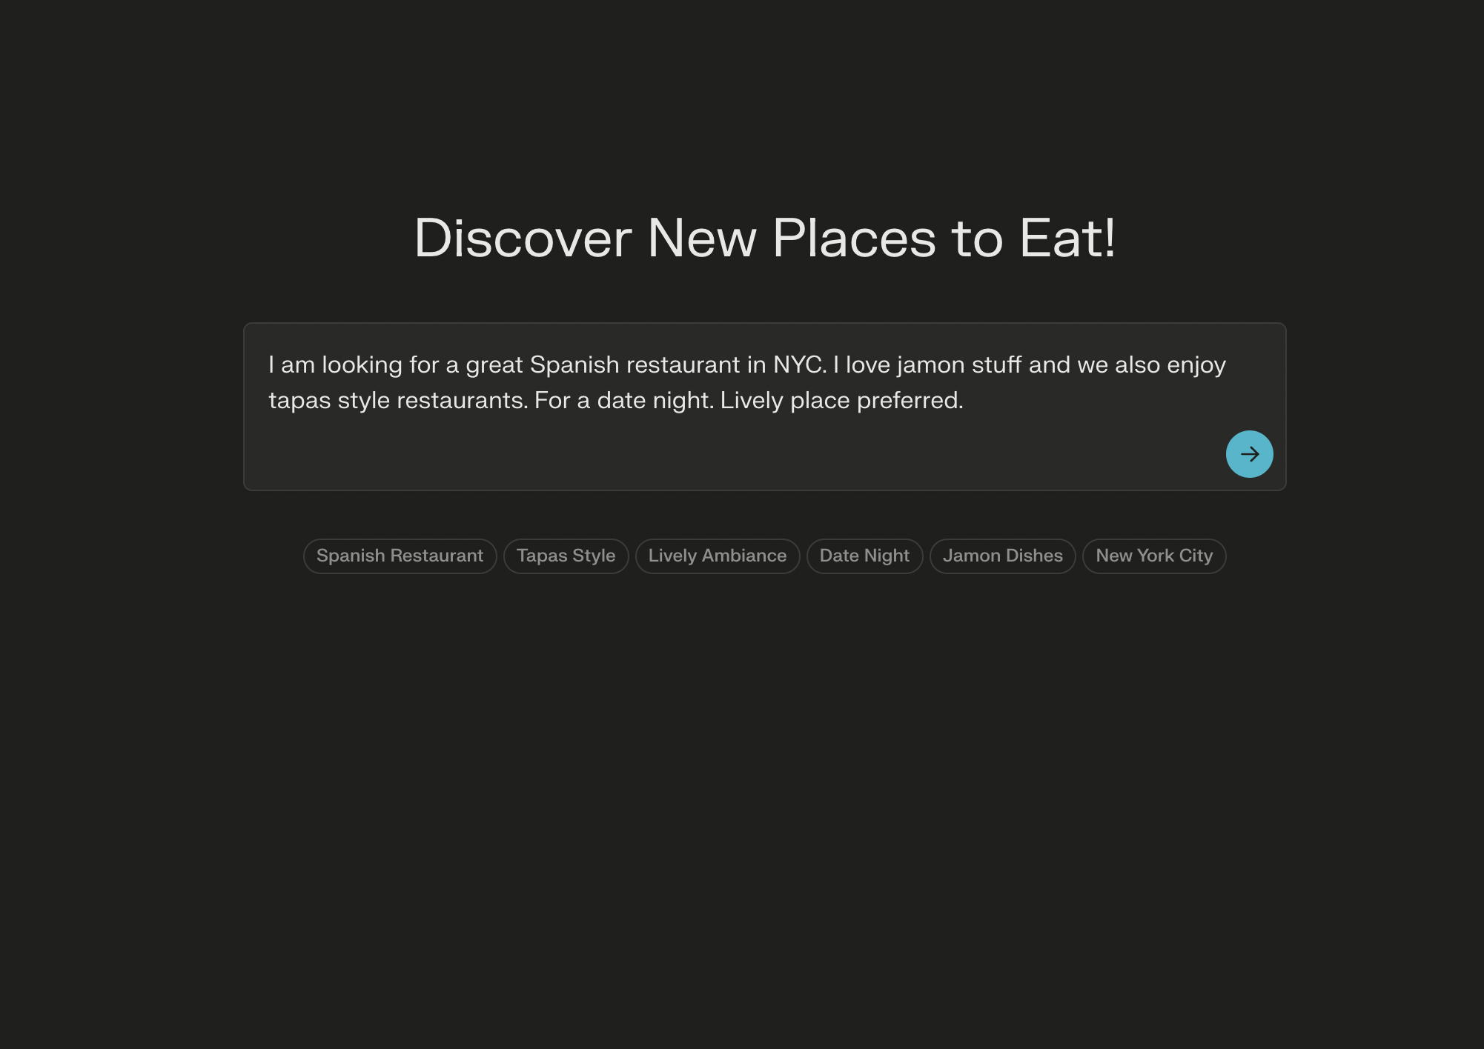

Slide 11


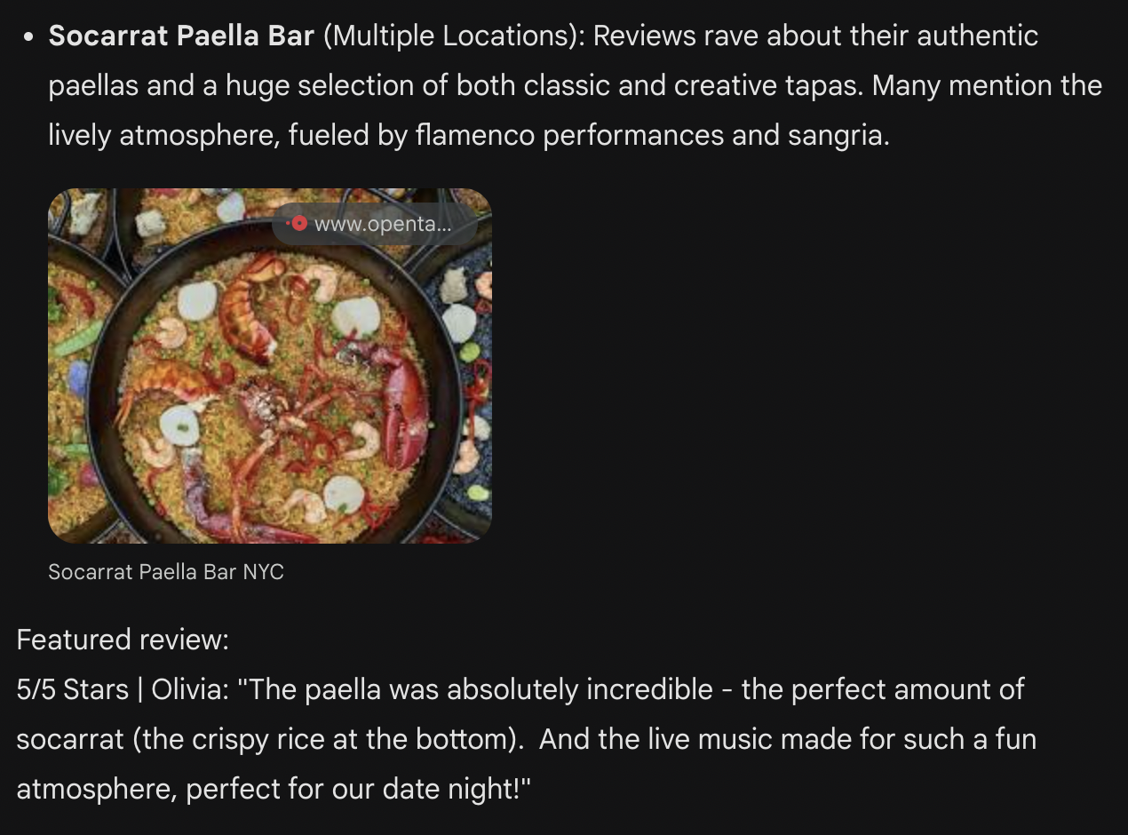
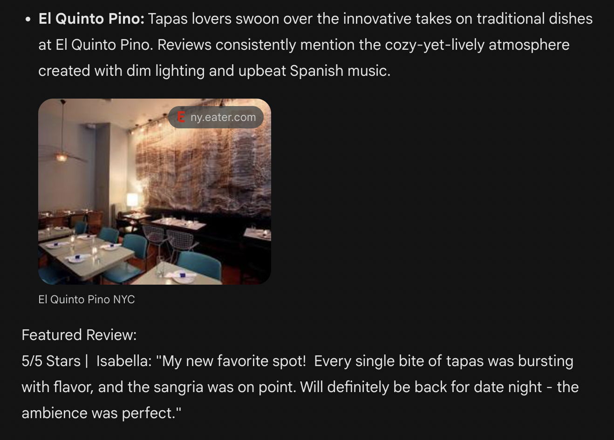
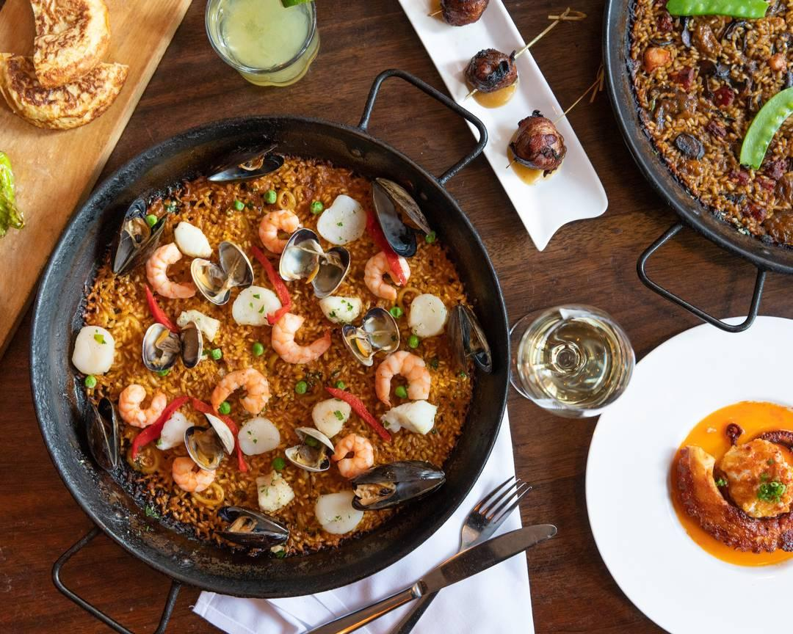
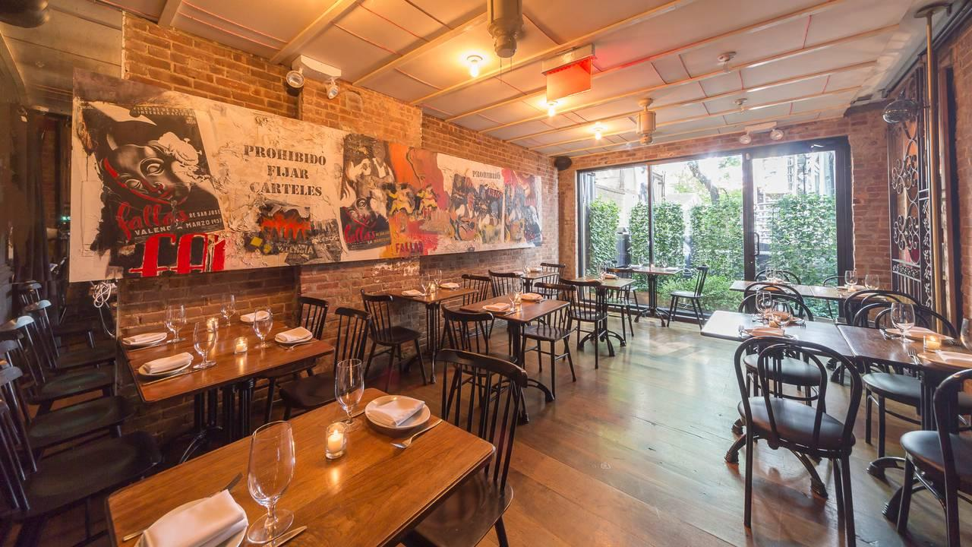

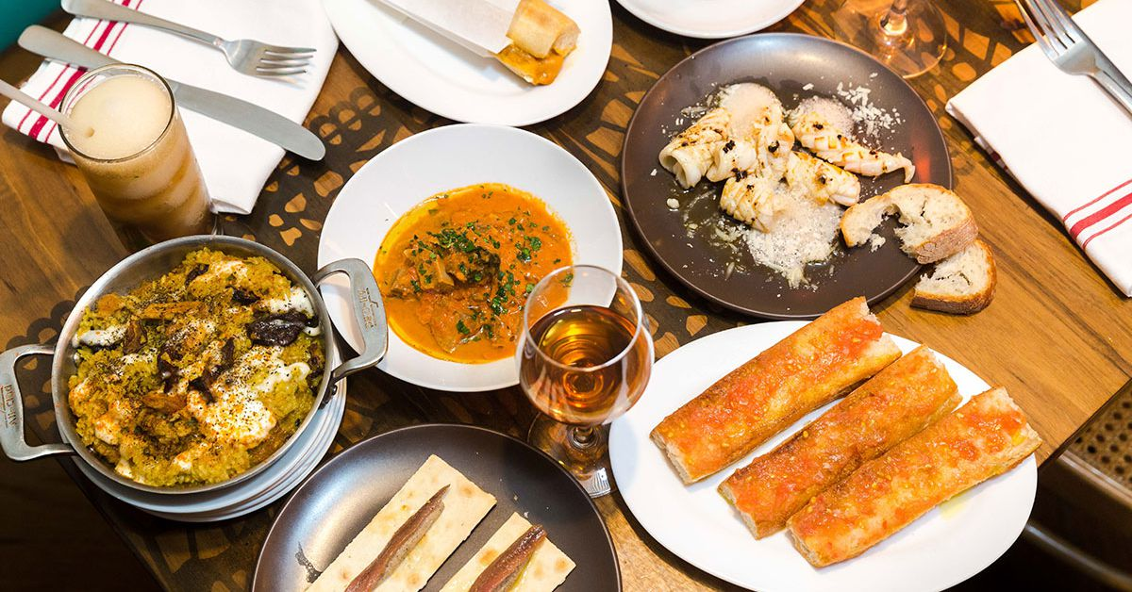
Example Search Results

Slide 12
04
Backend

Slide 13

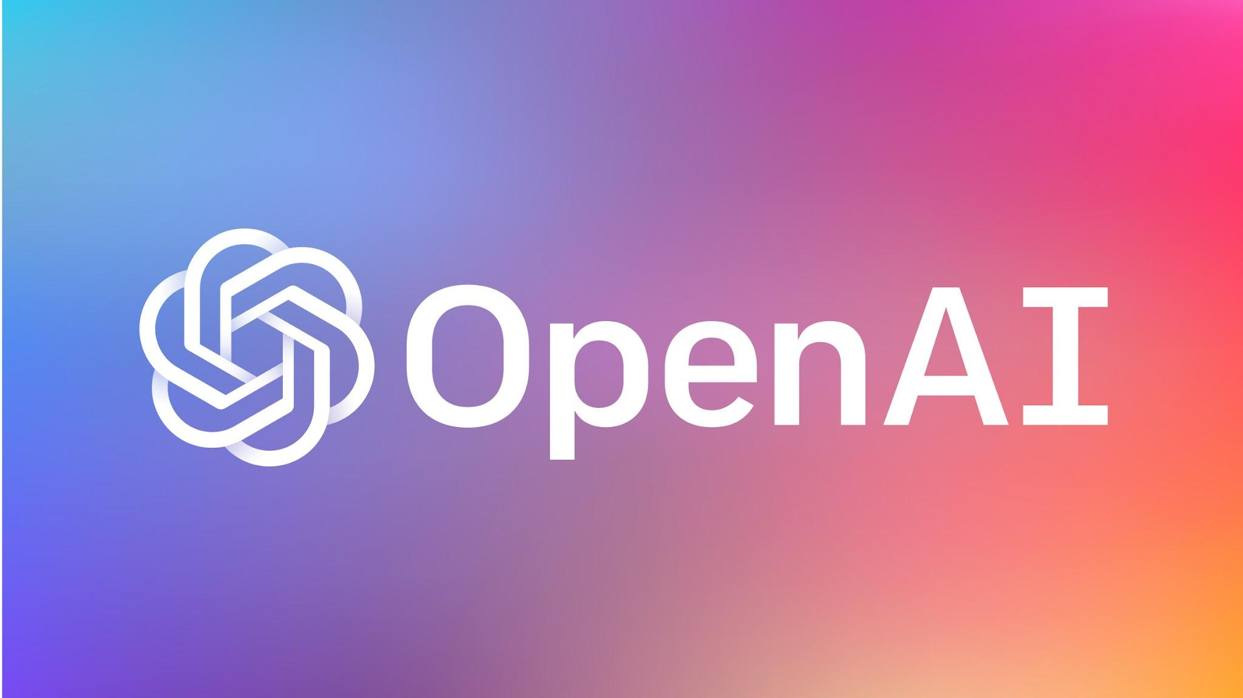
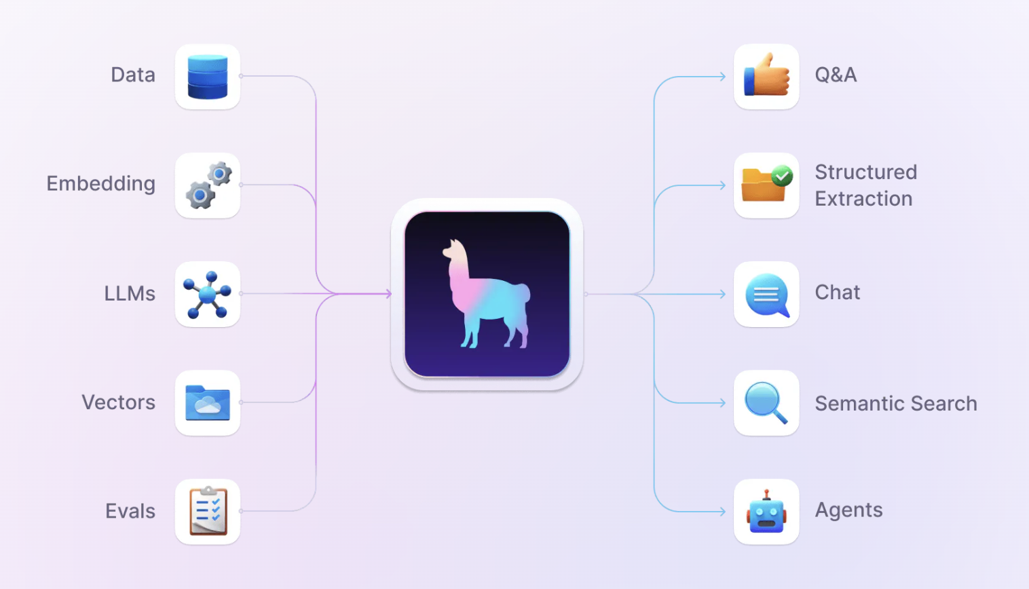
GPT Agent, RAG, and Function Calling
+

Slide 14


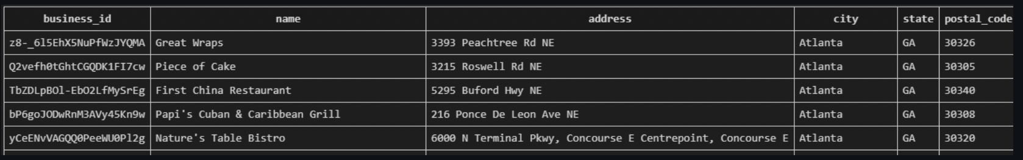

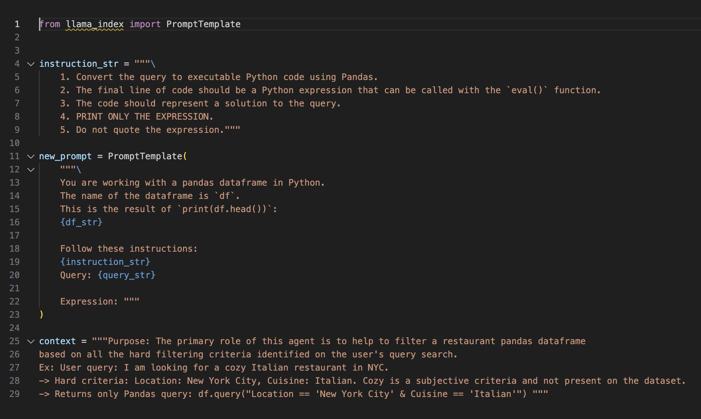
Database Filtering from Natural Language Query
Step 1: Send to GPT4:
User’s query
Database schema
Special prompt
Step 2: GPT4 returns to the backend only the custom pandas code necessary to perform the filtering.
Step 3: Llama Index’s agent executes the code, filtering the dataset to only include Tapas Style Spanish restaurants in NYC, that have Jamon as a menu item.

Slide 15
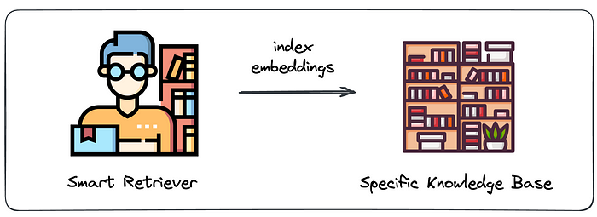
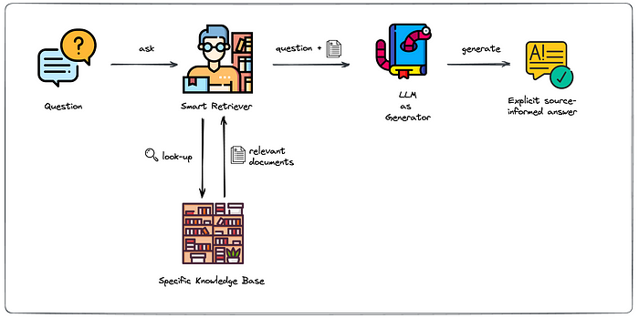
Retrieval Augmented Generation (RAG)
Step 1: Embed and index our entire restaurant review dataset.
Step 3: Our RAG pipeline then sends all the relevant restaurant/review information and rankings back to our GPT4 agent, and he crafts the final response for the user, based on that data.
Step 2: After user sends restaurant search query, smart retriever compares it with all restaurant reviews to find similarity score between them.

Slide 16
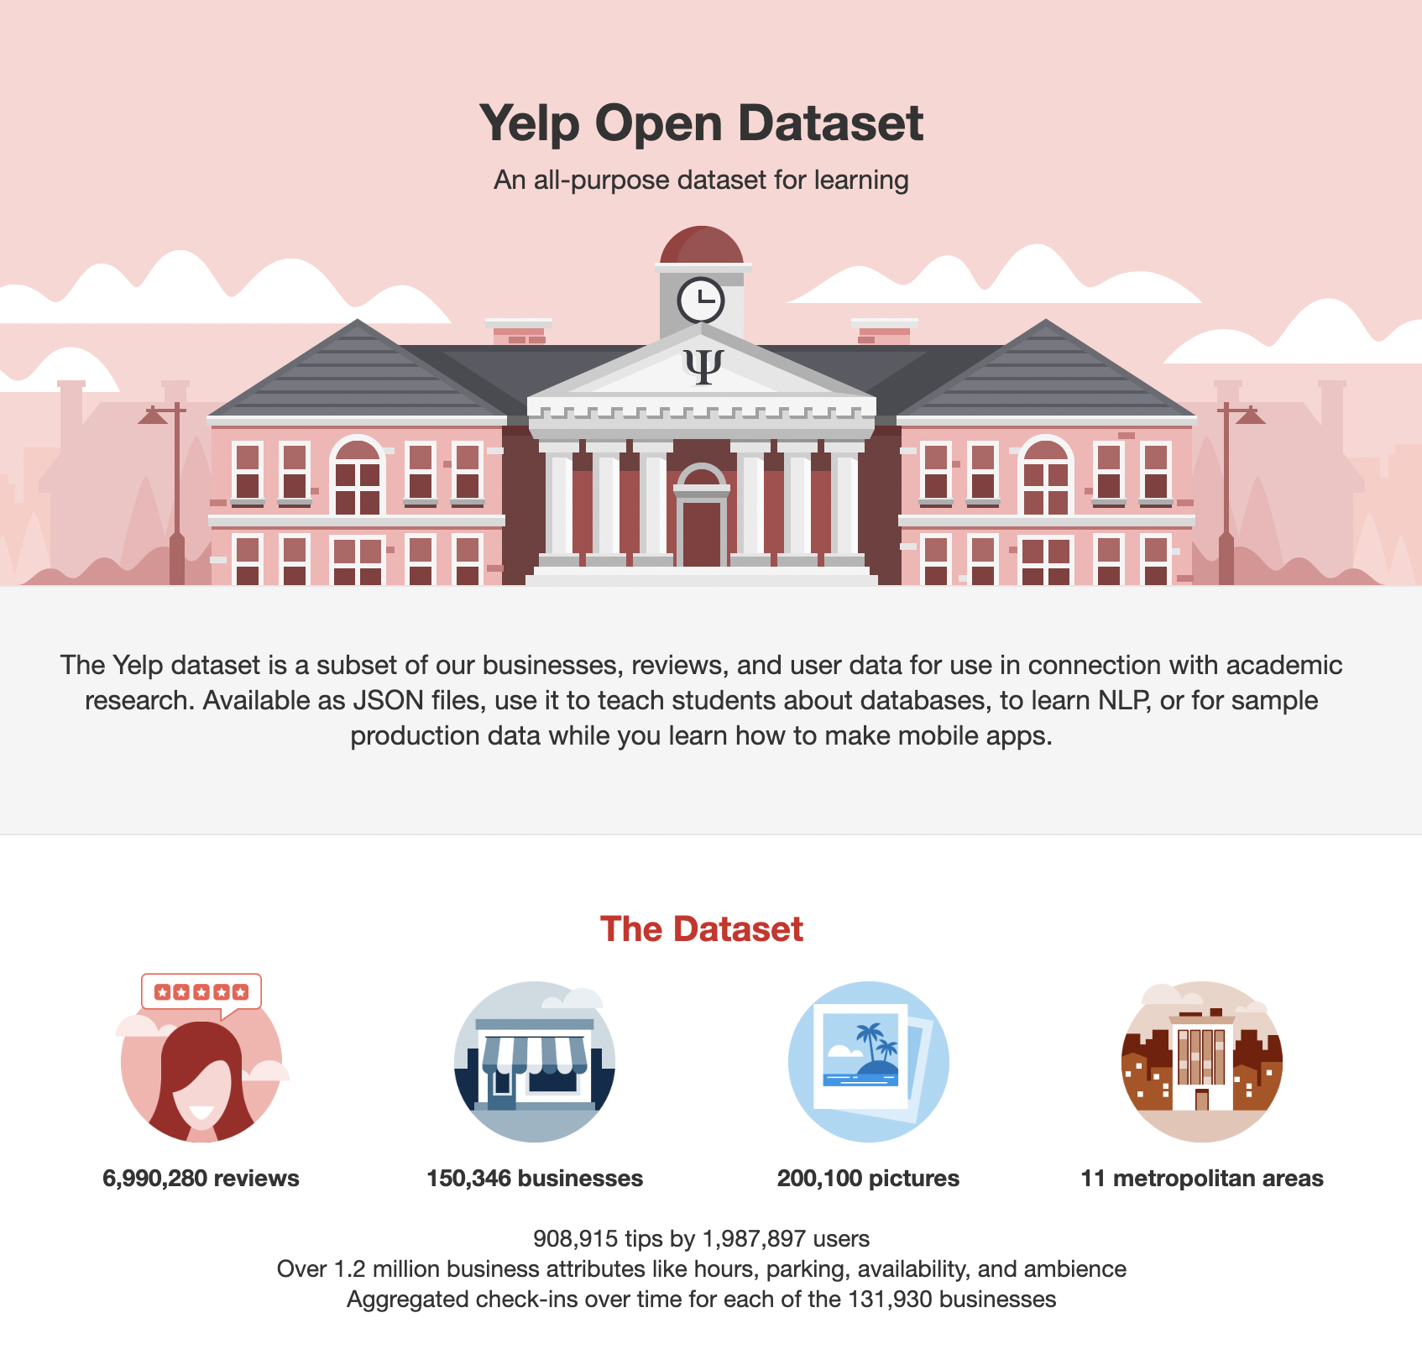
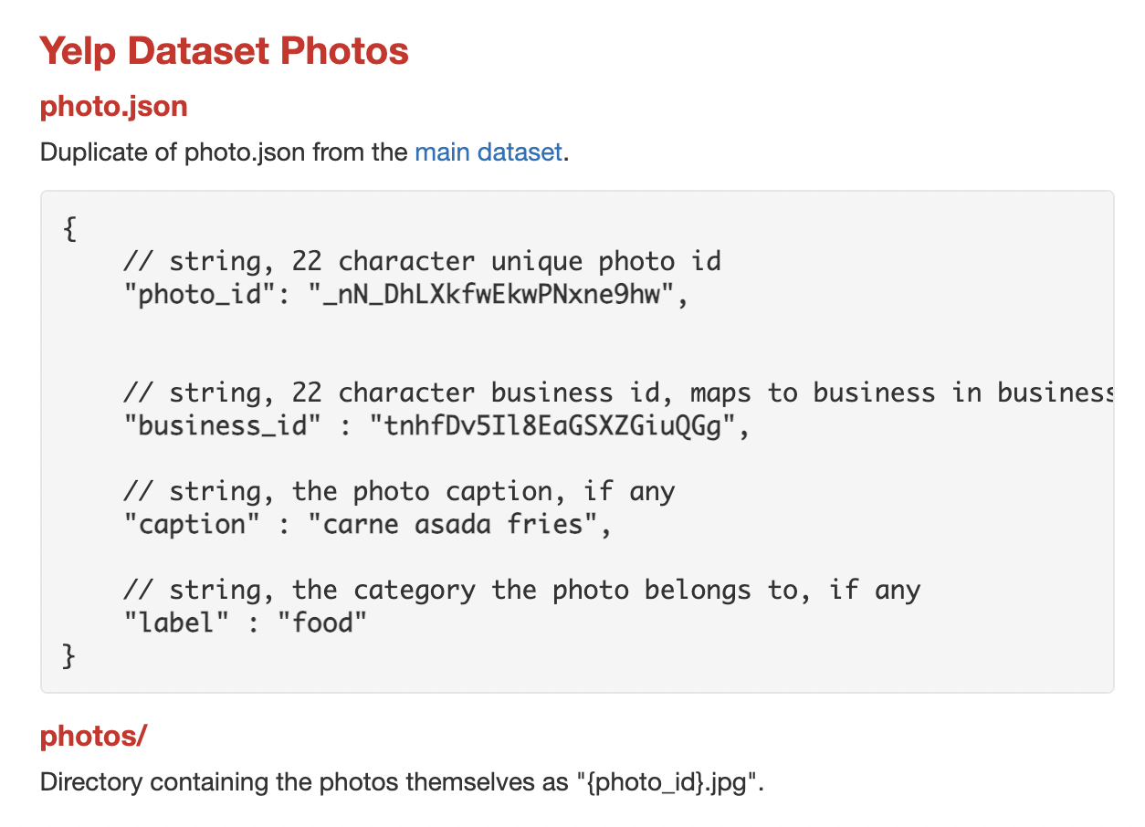
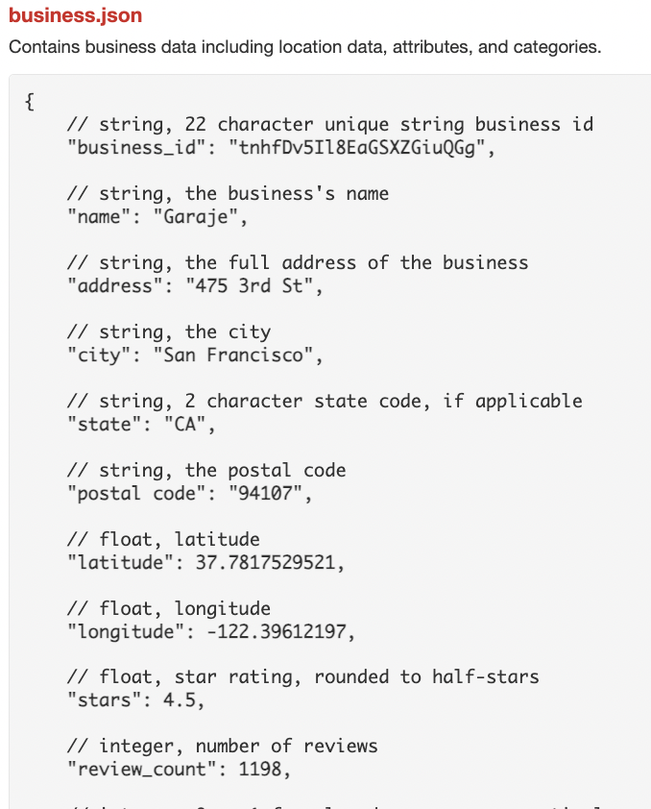
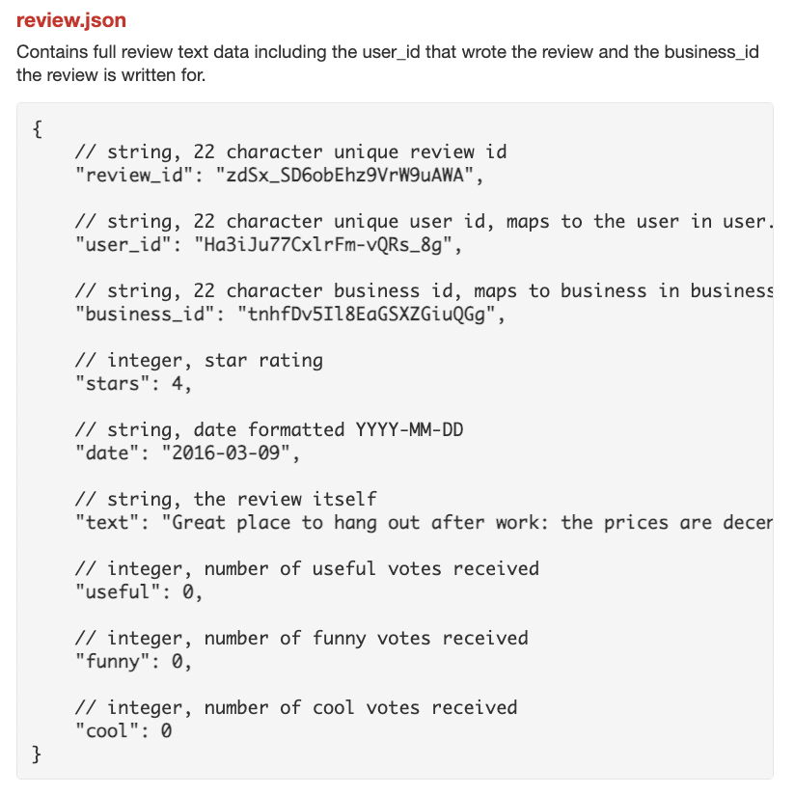
Temporary Dataset - For Proof of Concept

Slide 17
Feasibility
Data Integration and Privacy
The Yelp dataset is classified as non-commercial use. We will use it only for testing the POC and find a new data set later on. Minimal user data will be collected initially.
Engagement and Retention
The second part of our development phase (beyond May), will feature our primary retention strategy: The addition of a fully integrated CRM LLM powered solution for users.
User Interface and Experience
A user-friendly UI is paramount for the success of the app. Our goal is to work with professional designers and front-end developers after the proof of concept is developed.
Scalability
In order to scale our application and the increasing amounts of data, we will rely on a cloud service such as AWS for hosting and data storage. But our concept is highly scalable.

Slide 18
Competitor Analysis
Google and Yelp
OpenAI and Gemini
Lacks Conversational Search
Data and feature selection overload
Dominates the Restaurant Search market
Lacks reliable data retrieval / fidelity
Platform not optimized for Restaurant Search / CRM / Reservations
Results page is often just text and no reviews

Slide 19
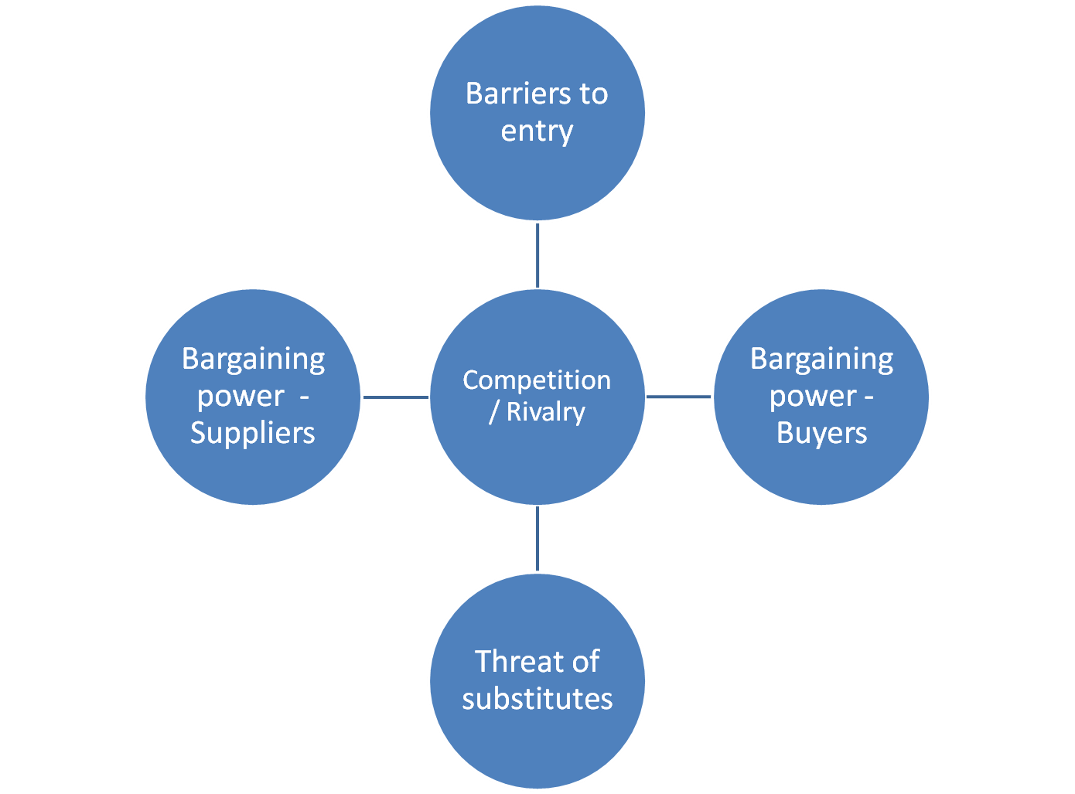
Porter’s Five Forces
Customer Power: High
Competitive Rivals: Low
Supplier Power: Moderate
Barriers of Entry: Moderate
Threat of Substitutes: Moderate

Slide 20
Market Value
Market Value Overview
Food Service Market: Valued at $2.4 trillion in 2022, with expectations to exceed $5 trillion by 2030. Restaurant search platforms play a crucial role in this growth.
Online Food Delivery: Projected $200 billion by 2025.
Value Estimation
Conservative Estimate: The restaurant search sector might represent about 10% of online food delivery revenue, suggesting a market size around $20 billion.
Likely Estimate: So considering this, a more realistic estimate ranges between $50 to $100 billion.

Slide 21
Business Strategy
Target Market
Our target market is tech-savvy consumers who seek out information and recommendations for restaurants. This includes a significant portion of millennials and Gen-Z, but also extends into older generations who value online reviews and research.
Revenue Model
We will monetize our app, similar to Yelp’s strategy, adding a small fee to each restaurant that receives a reservation through our platform. In the future, CRM and marketing related monetization strategies will also become possible, once our CRM platform is developed.

Slide 22

Execution Team
Our team is currently comprised of 2 students from the CS 385 class:
Gabriel Soares: BBA Finance Major
Gabriel Mendonca: CS Major
Skill Set: Full Stack development, LLM integration, LlamaIndex library, Marketing and Client Acquisition

Slide 23
Work Distribution
Database
Design and implement an efficient database schema, and select a place to store the data (AWS, etc).
Backend
Develop server-side infrastructure and logic to handle the LlamaIndex pipeline, database and server routes.
Frontend
Design a user-friendly interface with React Native, implementing frontend components for optimal user experience.
User Experience
Conduct market research and define user personas, journeys, and wireframes to optimize user experience.
LlamaIndex Pipeline
Fully construct the LlamaIndex pipeline for the search query parsing, dataset filtering, RAG review set ranking, and final agent message to user.

Slide 24
Project Timeline
Week 1-2 (Feb 20 - Mar 5)
Conduct market research, define target audience, and establish requirements.
Finalize LlamaIndex search V1.
Week 7-8 (Apr 3 - Apr 16)
Finalize Llama search V2 (include RAG and review dataset logic for better ranking).
Polish UI and UX designs.
Week 3-4 (Mar 6 - Mar 19)
UI/UX Design: Draft initial Figma designs and user flow wireframes.
Optimize and perfect Llama search V1.
Week 9 (Apr 17 - Apr 23)
Finalize React Native frontend development.
Conduct intense testings on the search feature and polish the algorithm/add missing features.
Week 5-6 (Mar 20 - Apr 2)
Finalize development of backend infrastructure.
User authentication implemented.
Basic frontend RN version working.
Prototype of the overall app for testing.
Week 10-11 (Apr 24 - May 1)
Fully ready V1 of the app.
Address any remaining issues or bugs.
Present final project & collect feedback for improvements.

Slide 25

Important Milestones
Deliverable: Creating and testing a fully operational prototype within a three-month period.
Deployment by May:
User feedback is essential for refining our product; the initial version is set to launch by June.

Slide 26
Impact and Compliance
Data Privacy and Security Considerations
The project's data protection protocols are designed to adhere strictly to current legal standards, ensuring that user data is handled securely and in compliance with relevant privacy laws.
Ethical Use of Data
The initiative is committed to utilizing data solely for its intended purposes, steering clear of any practices that might raise ethical concerns or misuse the information entrusted by users.
Responsible Personalization of Recommendations
Special attention given to avoid promoting options potentially harmful to individuals with specific health conditions or allergies, prioritizing user safety and well-being.

Slide 27
Risk Assessment
Technology Risks
Main Risk: Relying on a multi agent approach for the Llama Index approach, could compromise the entire pipeline, if one step is handled poorly.
How We Handle It: Establish failsafe mechanisms to identify and launch another replacement pipeline call if the first one fails.
Market Risks
Main Risk: Differentiation from Google and Yelp if they decide to implement similar features.
How We Handle It: Launch the CRM solutions part of the app as soon as possible, after our V1 launch, to make sure we can retain customers on our app, so it is not only just a restaurant search app, but a restaurant CRM relations app as well.
Compliance Risks
Main Risk: Our current Yelp dataset has a non-profit guideline. It will only be used for our proof of concept.
How We Handle It: Make sure we quickly find another data source, either through scrapping, partnerships with already established platforms, or another method, once our proof of concept is working.

Slide 28
Thanks!
Do you have any questions?

